Slide 1

RISK AND RESILIENCE BOOTCAMP
1

Slide 2


Slide 3

Risk governance
This module introduces and explores some of the foundational concepts of risk governance
Risk appetite
Risk tolerance
Risk capacity
Risk culture

Slide 4
Introduction
Risk governance
While pursuing strategic objectives, organizations have to determine
How much risk the organization is prepared to undertake
How much risk the organization can absorb and tolerate
Risk governance sets the appropriate level of risk to optimize operations
ISACA definitions
Risk Appetite: How much risk the enterprise is willing to undertake
Risk Tolerance: The acceptable range of risk induced deviation from objectives
Risk Capacity: The maximum risk related losses the enterprise can bear before its viability is threatened
Risk Culture: The shared values, norms, and behaviors that shape how people in the organization identify, assess, and respond to risk
Similar concepts exist across risk standards and frameworks
Each standard or framework provides its own formal definition
The various definitions restate these ideas, tailored to their specific audiences

Slide 5
Risk Appetite
Risk appetite
The broad-based amount of risk an entity is willing to accept in pursuit of value
For example
“Although the enterprise desires to have no appetite for IT risk, it recognizes that this is impractical in the achievement of its objectives. Therefore, the enterprise will remediate loss scenarios in which aggregate losses of $1 million or more are at risk.”
Dimension of risk appetite
Objective capacity to absorb loss across multiple asset categories
For example: capital adequacy, liquidity, reputation, operational assets
Management’s predisposition to risk: cautious vs. aggressive culture
Nature of business and risk types: operational, cyber, credit
Risk appetite can vary across business functions or categories within an organization
Best practices
Risk appetite must be quantified in order to support risk decisions
Reviewed periodically to reflect changes in the organization and/or business environment
Integrated into IT governance, investment, and cybersecurity planning

Slide 6
Risk Tolerance
Risk tolerance
The acceptable variation in actions relative to objectives that would result from accepting risks
Sets “guardrails” to define acceptable levels of risk for specific operations or actions
Translates risk appetite into measurable performance indicators such as KPIs or SLA limits
Example
“Projects are to be completed within estimated budgets and timeframes, but overruns of 10 percent of budget or 20 percent of time are tolerated.”
Relationship to appetite
Risk appetite = strategic-level willingness to take risk at the enterprise level
Risk tolerance = operational thresholds of acceptable deviation at the business unit

Slide 7
Risk Capacity
Risk capacity
The amount of loss an enterprise can tolerate without risking its continued existence
It represents the upper bound beyond which potential losses due to risk threaten survival of the enterprise
Sustainable scenario
Risk capacity > risk appetite > actual risk
When actual risk exceeds capacity, resilience and solvency are threatened
Quantitative measurement of operational continuity capability
Defines the ceiling within which appetite and tolerance are set
Banks often align this with regulatory ratios

Slide 8
Risk Culture
Risk culture
The collection of behaviors and values that support open risk discussions and consistent adherence to risk policies
A risk-aware culture
Promotes open discussion of risk
Ensures alignment between policies, appetite, and actual behavior
Recognizes risk-taking as necessary for innovation, but within managed limits
Key behaviors
Proactive identification: Early escalation of risk indicators
Ownership and accountability: All staff own risk, it’s not just the responsibility of IT or compliance
Transparent communication: Avoid hidden agendas and blame culture
Alignment with objectives: KRIs and decisions aligned with enterprise goals
Learning from negative outcomes: Post-incident reviews that address root causes

Slide 9
Risk Culture
Risk culture
Symptoms of poor risk culture
Misalignment between appetite, tolerance, and policy
Failure to enforce risk policies
A blame culture that discourages transparency and collaboration
Summary
Risk capacity = maximum loss the organization can survive (CFO / CRO)
Risk appetite = desired level of risk to achieve strategy (board / exec mgmt)
Risk tolerance = operational thresholds of tolerated variation (business units)
Risk culture = Norms influencing behavior toward risk (everyone)

Slide 10
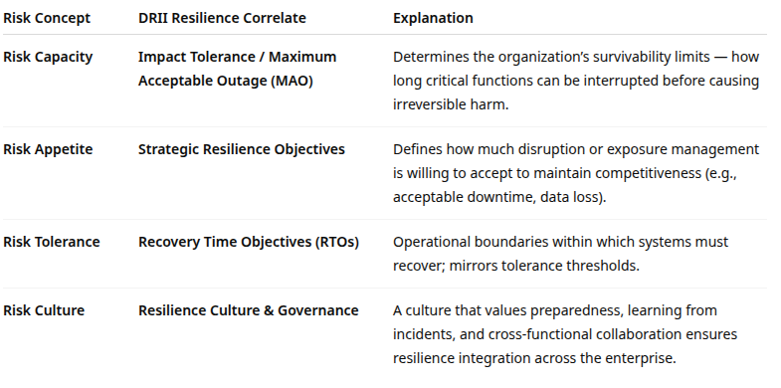
Correlation with Resilience

Slide 11
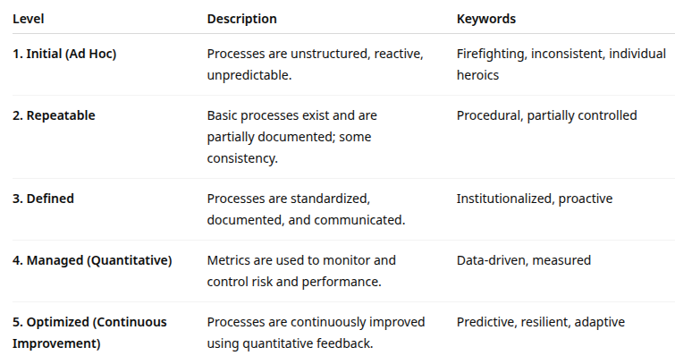
Theory vs reality
The concepts presented so far are theoretical
But the ability to be effective in each of these areas depends on the process maturity of the organization
The maturity definition recap below describes the process of becoming risk culture “mature”

Slide 12
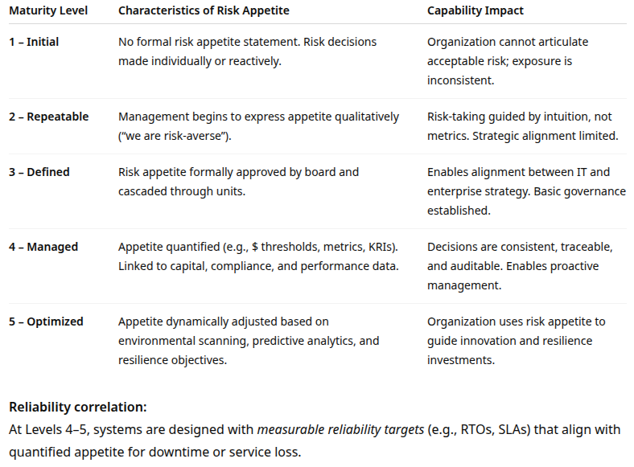
Risk Appetite and Maturity

Slide 13
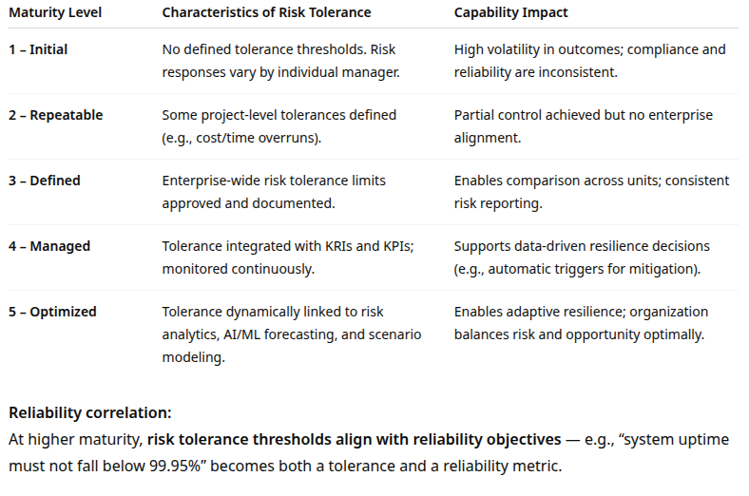
Risk Tolerance and Maturity

Slide 14
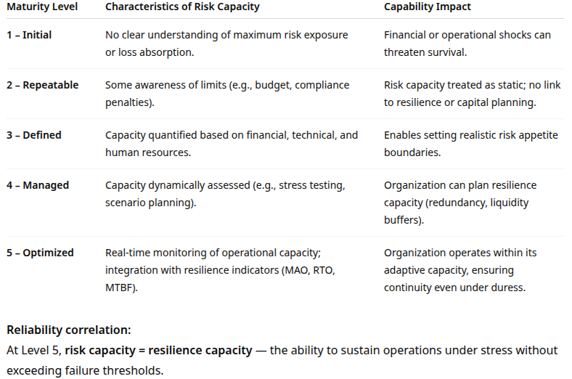
Risk Capacity and Maturity

Slide 15
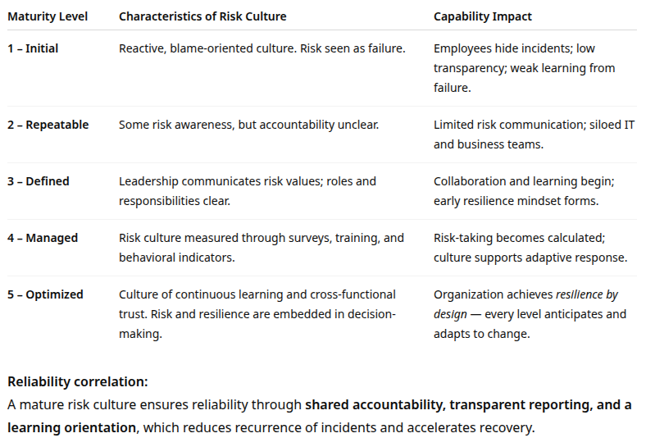
Risk Culture and Maturity

Slide 16
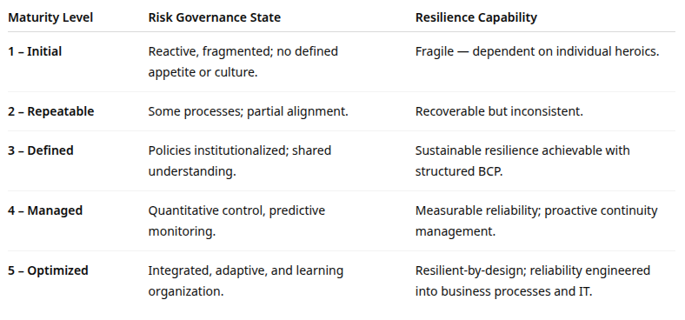
Maturity vs. Resilience Capability

Slide 17
Maturity implications
Maturity drives control
Without process maturity, risk frameworks remain theoretical
Quantification enables resilience
Risk appetite and tolerance translate into measurable reliability and resilience goals
Culture amplifies capability
A mature risk culture transforms risk awareness into resilient behavior
Risk capacity defines operational limits
Resilience planning begins by understanding the true risk capacity of critical functions
Integration is the goal
Risk and reliability management converge under a unified resilience framework

Slide 18
Risk culture
The result of combination of external and internal factors
External or environmental
Sets boundaries, incentives, pressures, and references for “acceptable” risk behavior
Regulatory environment
Legal and compliance pressures
Industry norms and peer benchmarking
External stakeholder expectations
Macro geopolitical environment
National culture and societal norms

Slide 19
Risk culture
Internal or organizational
Shape day-to-day behaviors, decision processes, risk escalation, and collective mindsets
Leadership behavior and tone from the top
Incentives, performance measurement and rewards
Governance structure and oversight
Communication and information flows
Subcultures and functional silos
Historical incidents and “lessons learned”
HR practices: hiring, onboarding, training
Formal systems and control architecture

Slide 20
Risk external culture
Regulatory
Supervisory regime and enforcement intensity
Banking and financial services regulators often impose culture and conduct expectations as part of regulatory guidance or exams
For example “culture of compliance” and “risk culture expectations”
Threat of regulatory penalties, fines, or reputational sanctions motivates organizations to embed risk culture more robustly
In environments with weak enforcement, organizations may pay lip service to “risk culture” while focusing compliance efforts on ticking boxes
Example
A bank subject to regular regulatory audits may emphasize rigorous risk escalation and whistleblower frameworks
A non-regulated technology firm might have more latitude to undertake risk without triggering external attention or investigations

Slide 21
Risk external culture
Industry norms
Peer benchmarking and competitive pressures
Peer benchmarking: comparing an organization’s performance, processes, or risk posture against similar organizations
Industries with high reputational risk have peer expectations that create norms
High reputation risk example, banking, insurance, pharmaceuticals, energy
Fore example: “Every major bank must have a ‘first-line, second-line, third-line’ risk culture.”
Benchmarking reports create aspirational pressure
For example: “Top-tier banks have X maturity level in risk culture”
If competitors tolerate more risk or cut corners
Can either erode culture by triggering a “race to the bottom”
Or provoke stronger counter-measures to differentiate on trust

Slide 22
Peer benchmarking
Peer benchmarking
Measuring the organization against comparable institutions
For example, banks compare their incident response times, cybersecurity controls, recovery objectives, or capital/risk exposure to other banks of similar size and complexity
Identifying gaps and leading practices
If peers have stronger resilience testing, stricter third-party oversight, or faster notification capabilities, regulators may expect the organization to close the gap
Providing evidence to regulators and auditors
Benchmarks help show that the organization’s risk posture is not only internally acceptable but also aligned with industry norms and supervisory expectations
Supporting KRIs, governance, and strategic decisions
Metrics like RTOs, vendor performance, staffing levels, or breach frequency are benchmarked to evaluate whether the organization’s targets and thresholds are realistic and defensible

Slide 23
Peer benchmarking
Goals of peer benchmarking
To ensure firms don’t fall significantly behind industry norms
To encourage consistent practices across institutions
To identify systemic weaknesses across a sector
To justify improvements, resources, or investments in controls

Slide 24
Risk external culture
Legal
Occurs in jurisdictions with strict liability, class-action exposure, or heavy litigation
Organizations may become excessively risk-averse and suppress open discussion of near misses
In environments with weak liability, there is less external pressure to report or escalate issues
Macro-economic
Volatility in the economy forces more frequent, severe stress events
For example: volatility in financial markets, cyber threat landscape or geopolitical risk
Organizations in volatile environments often develop “risk hardiness” or more conservative cultures
More stable environments might breed complacency, overconfidence, or “it won’t happen to us” attitudes

Slide 25
Risk external culture
Societal culture
Differences in national culture shape
How people interpret authority
Whether they feel safe reporting bad news
Whether questioning the chain of command is acceptable, etc.
An empirical study found that national culture, industry type, and organizational security culture significantly influence individuals’ security behavior

Slide 26
Risk internal culture
Tone from the top
Leadership actions speak louder than policies
If senior executives bypass controls, dominate decisions without discussion, or penalize risk disclosure, they undermine culture
When the board or CEO publicly demands risk transparency, participates in discussions, and visibly supports risk escalation, that sets a cultural anchor
In studies of ERM sophistication, organizations where leaders push for stronger oversight show higher maturity in risk culture

Slide 27
Risk internal culture
Incentives
Misaligned incentives generate cultural tension between actions mitigating risk
For example: rewarding revenue growth without penalizing risk overruns
Risk management failure arises when short-term individual incentives conflict with long-term enterprise risk appetite.
If risk controllers or compliance units are not part of performance evaluations, their voice may be sidelined

Slide 28
Risk internal culture
Governance structure
Where risk governance is weak culture is less capable of intervening
For example: Risk committees that never challenge or risk functions under powered
Clear accountability lines and escalation paths matter: who owns risk, who can override, who judges exceptions
Frequency and seriousness of oversight affect how risk culture stays alive day to day

Slide 29
Risk internal culture
Information flow
A “speak-up” environment where there are channels for escalation, anomaly reporting, whistleblowing
If information is hoarded in silos or filtered upward aggressively, senior leadership gets distorted views
Informal networks, like power centers and shadow communication channels, can override formal governance.
McKinsey notes that informal networks often influence how formal risk channels operate in practice

Slide 30
Risk internal culture
Functional silos
Large organizations often have multiple micro-cultures
For example: development, operations, risk, audit
These different micro-cultures may have varying attitudes to risk
This can create subculture conflict
For example: DevOps striving for rapid release conflicts with security requiring cautious rollout
Historical memory
Past failures, “near misses,” or regulatory fines leave cultural legacies
Either fear-based suppression or learning orientation based on transparent root cause reviews
Organizations that do after-action reviews, “lessons learned” loops, and close the loop by changing practices build a stronger risk culture over time

Slide 31
Risk internal culture
Control systems
The architecture of controls, systems, metrics, dashboards, and analytics reinforce or weaken culture
If control systems are opaque, overburdensome, or disconnected from decision-making, they may generate bypassing or cynicism
The strength of risk measurement, like KRIs and predictive analytics, can influence how visible risks are, and how credible the risk function is

Slide 32
Appetite vs. Tolerance
Risk Appetite
Strategic-level statement of how much risk and of what types an organization is willing to accept in pursuit of its objectives
Forward-looking, aspirational, and reflects the risk culture
Risk Tolerance
Translates risk appetite into operational thresholds or boundaries of acceptable deviation
Quantifies appetite within a framework of real world constraints

Slide 33
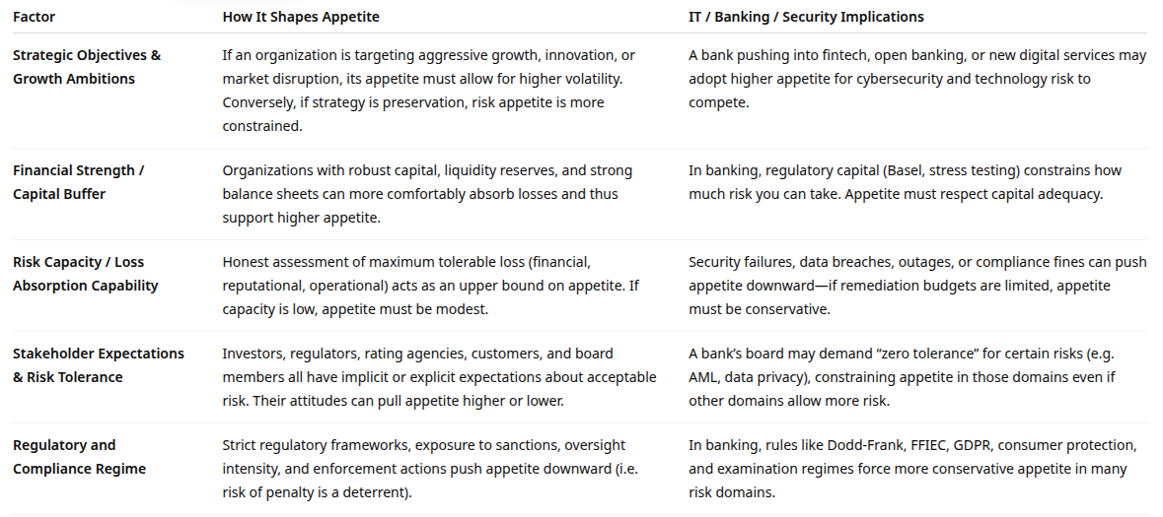
Factors Influencing Risk Appetite

Slide 34
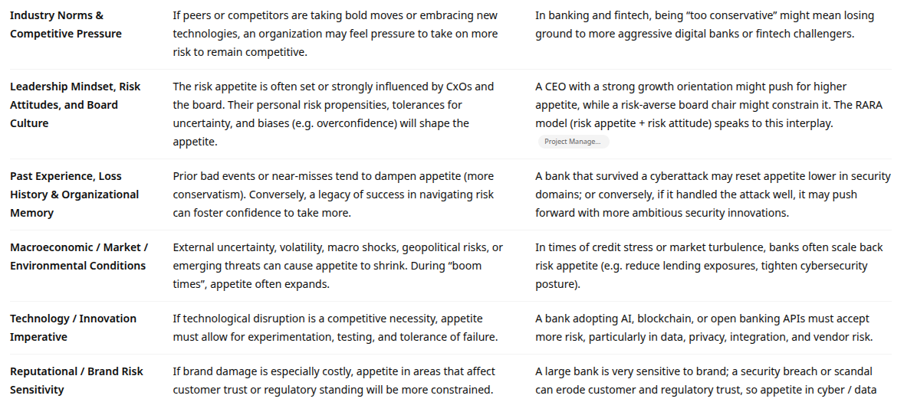
Factors Influencing Risk Appetite

Slide 35
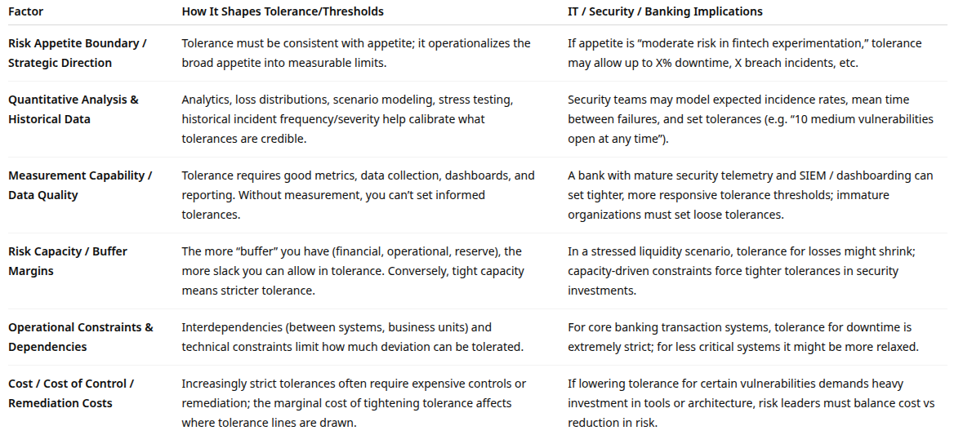
Factors Influencing Risk Tolerance

Slide 36
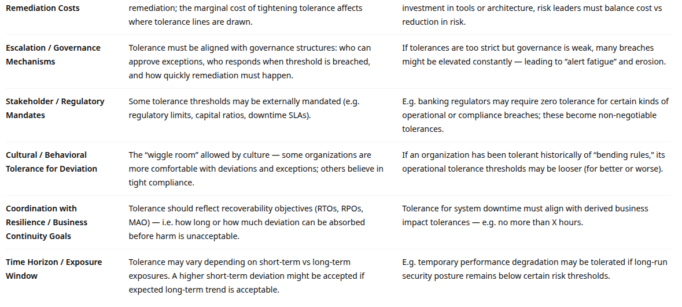
Factors Influencing Risk Tolerance

Slide 37
Risk tolerance
Tolerance is often expressed in dual limits
Minimum and maximum, or multi-dimensional thresholds like financial, time and severity dimensions
Minimum limits prevent total risk avoidance policies and behaviors
Tolerances must be reviewed and recalibrated periodically
As systems evolve and threat profiles shift, tolerances that were once acceptable may become dangerous
Measurement or monitoring may be immature
Organizations may define coarse tolerances like low/medium/high bands rather than quantified numerical thresholds

Slide 38
Risk Trade-Offs
Appetite vs capacity constraints
No matter how ambitious appetite is, it must not exceed capacity or the organization becomes in danger of insolvency or collapse
Tolerance cost vs benefit
Tightening tolerance with smaller deviations often increases control and remediation costs
Strategic ambition vs regulatory constraints
Appetite to innovate might push for looser tolerance
But regulators or standards may force stricter tolerance in certain domains, like data privacy
Measurement maturity vs precision of tolerance
Immature measurement capabilities force broader tolerances that may allow more risk
Culture and behavior vs tolerance enforcement
If the culture routinely grants exceptions or ignores breaches, tolerance has little real effect

Slide 39
uncertainty
The amount of unavoidable variance in future predictions of external factors
Essentially, the risk of not being able to predict the future with certainty
For example: The impact of AI on the economy and banking
For example: Inconsistent or changing positions on major regulatory issues
Uncertainty options
Commit to one possible outcome
High level of risk but potentially high level of returns
Spread the risk
Make investments in the different alternatives, hedging bets
Ignore the uncertainty
Assume the status quo will continue, often the worst possible choice

Slide 40

Q&A and open discussion
Notes:
Now is the time to engage in an interactive Q&A session where you can ask questions, share insights, and clarify any doubts about the topics we have covered so far.
This open discussion is designed to ensure that every participant has the opportunity to voice their thoughts and learn from the collective experience of the group.
Your questions and comments are valuable as they help us identify areas that may need further explanation and enable us to tailor future sessions to your needs.
We encourage you to speak up and contribute to the dialogue, as this interaction is one of the key components of our interactive learning approach.
As the session progresses, take note of any questions or ideas that you would like to revisit, and feel free to share your perspectives with the class.

